Slide 1
A Packet-Interleaving Scheme for Reliability Resilience under Burst Errors in Wireless Sensor Networks
Author: Tsang-Ling Sheu and Yen-Hsi Kuo
Publisher: ICN 2016
Presenter: Yi-Hao Lai
Date: 2016/08/31
Department of Computer Science and Information Engineering
National Cheng Kung University, Taiwan R.O.C.
Notes:
1
blocked TCAMs: SmartPC
power reduction on average (88%).
wastes considerable TCAM capacity

Slide 2
Introduction
To effectively deliver the collected data back to a control center for further analysis, a wireless sensor network (WSN) is usually built.
However, packet transmission over a WSN may encounter intermittent errors due to weak signals or interferences. The erroneous packets, if comprising of text or numbers, such as temperature or humidity, would require packet re-transmission, which increases network load.

Slide 3
Introduction
Thus, the motivation of this paper is to increase transmission reliability over a WSN.
Researches on transmission reliability over a WSN can be divided into two major categories
reliable routing
information coding
Notes:
2 bitmap types

Slide 4
Reliable routing
To increase the transmission reliability after data are collected by a sensor node, relay nodes (RNs) are employed.
R. Sampangi, utilized RNs to divide sensors into several cluster networks. Since the distance from a sensor to its cluster head is reduced, the quality of data transmission is greatly improved.

Slide 5
Information coding
E. Byrne, designed a coding scheme which can increase the probability of successful decoding based on graph theory.
Y. Hamada, proposed a scheme to reduce packet error rate by using Luby Transform (LT) codes. Their proposed scheme has achieved small complexity of O(n).

Slide 6
Propose scheme
We propose a packet interleaving scheme (PIS) based on Reed-Solomon (RS) codes to reduce the impact of burst errors on packet uncorrectable probability.

Slide 7
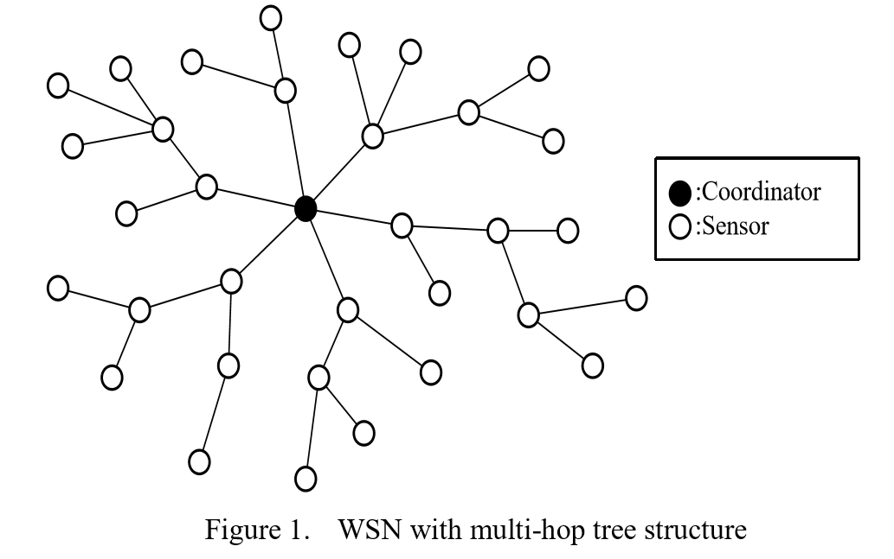
Multi-hop Tree Structure
In a wireless sensor network (WSN), a coordinator is the sink which gathers all the data collected from other distant sensor nodes.

Slide 8
Packet Interleaving
In the proposed PIS, packets collected by a sensor node are classified into two different types: high-reliability required (HRR) packet and non-HRR packet.
It is better to employ a shorter-length symbol (in this paper, we use m = 4) to encode an HRR packet with shorter data length.
Longer-length symbol (we use m = 8) to encode a non-HRR packet with longer data length.

Slide 9
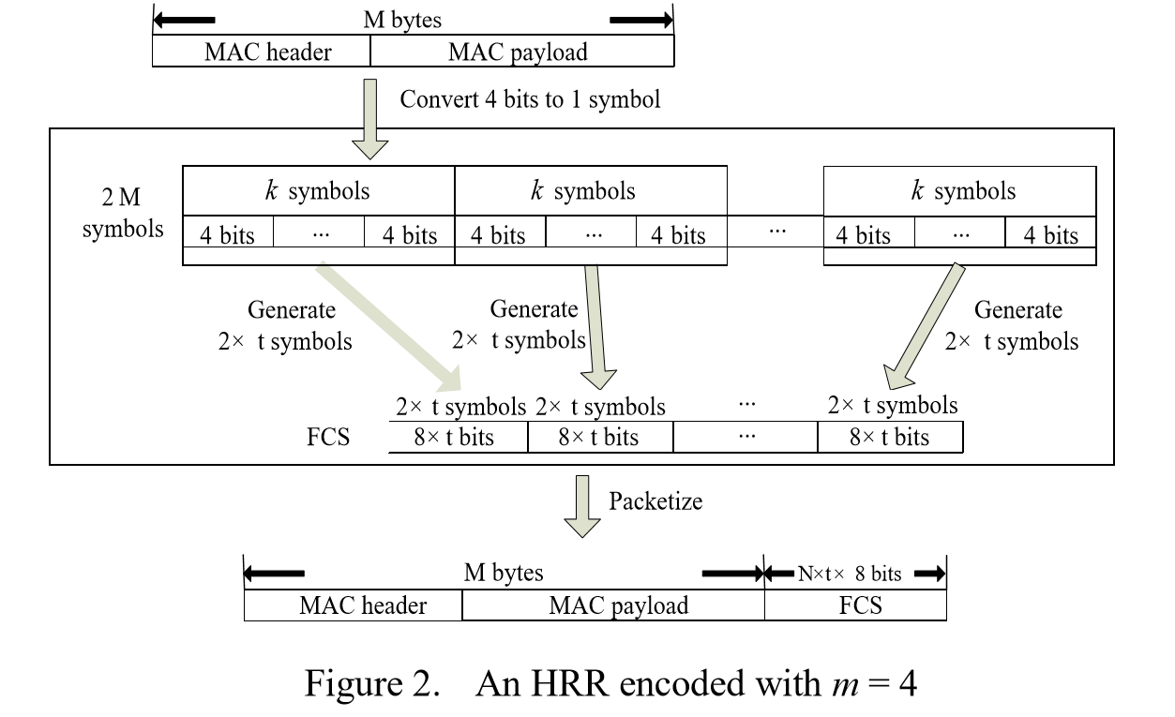
RS symbol
An HRR packet is encoded with a shorter-length RS symbol (i.e., m = 4).

Slide 10
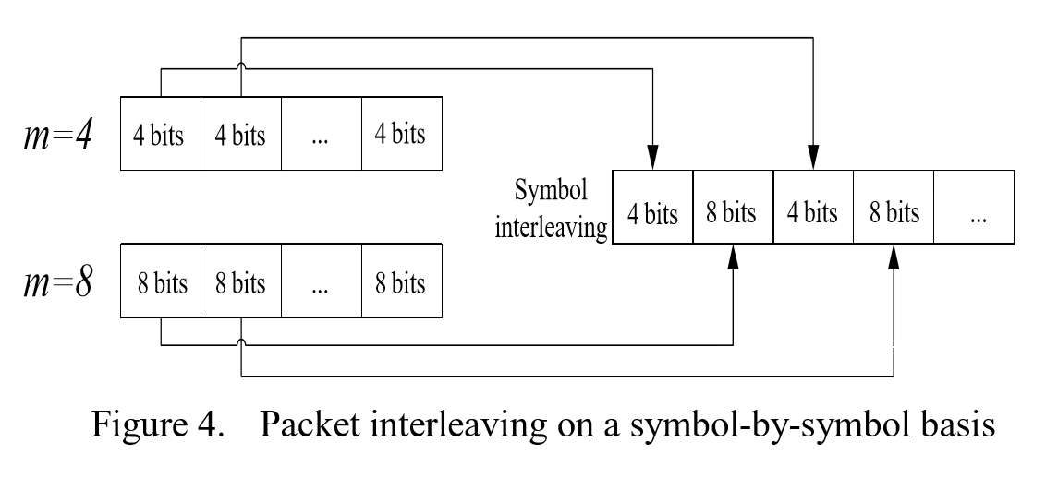
Packet Interleaving
When both an HRR and a non-HRR packet are received by a branch node in a tree-structured WSN, these two packets are interleaved on a symbol-by-symbol basis.
Notes:
R3 R8

Slide 11
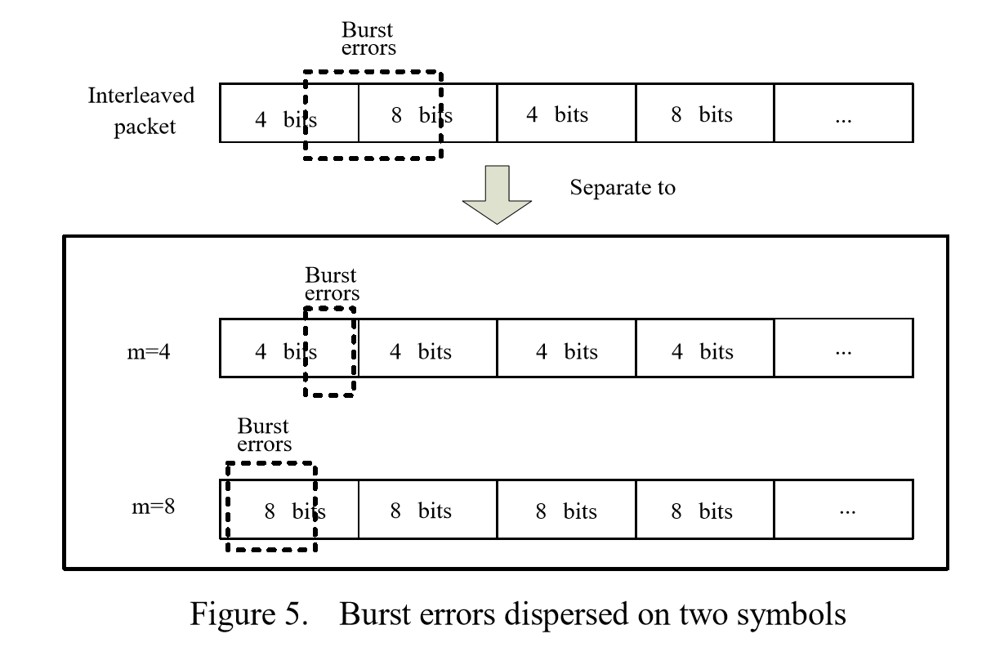
Packet Interleaving
However, an interleaved packet may not be correctable, if it encounters burst errors where the number of total errors is greater than t.

Slide 12
UBEM (uniform bit error model)
$P_{UB_be}$
$P_{UB_se}$ = 1 - ${\text{(1 − }P_{UB_be}\text{)}}^{m}$
$P_{UB_cuc}$ = 1 - $\sum_{i=0}^{t}{(\left({N_{s} \atop i}\right) \text{×} {\left(P_{UB_se}\right)}^{i}\text{×}{ \left(1−P_{UB_se}\right)}^{N_{s}−i})}$
$P_{UB_puc}$ = 1 - ${ \left(1−P_{UB_cuc}\right)}^{N_{c}}$

Slide 13
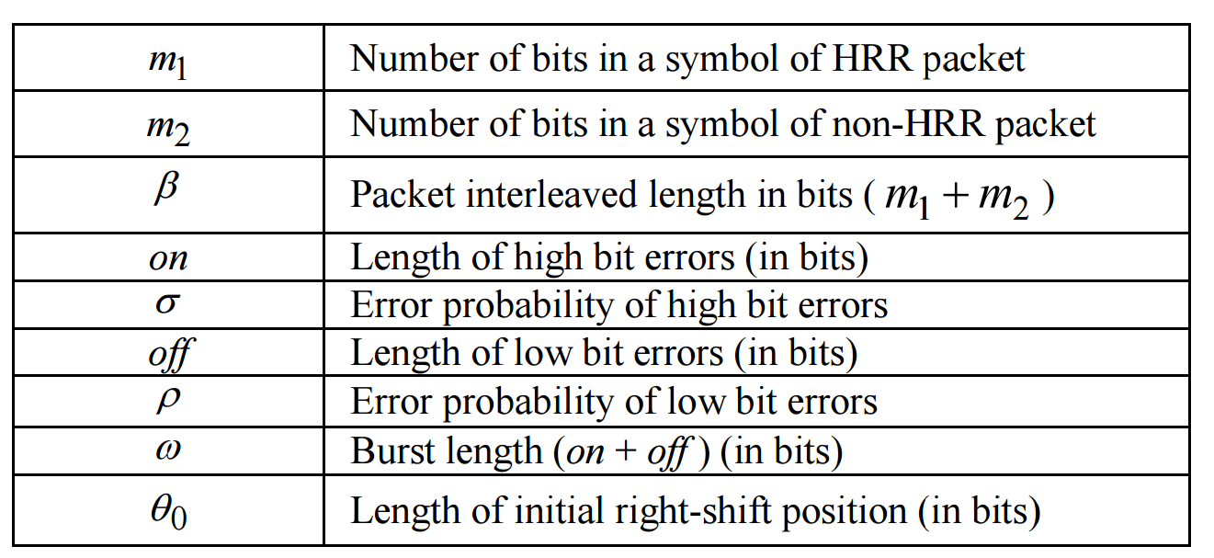
OBEM on-off bit error model

Slide 14
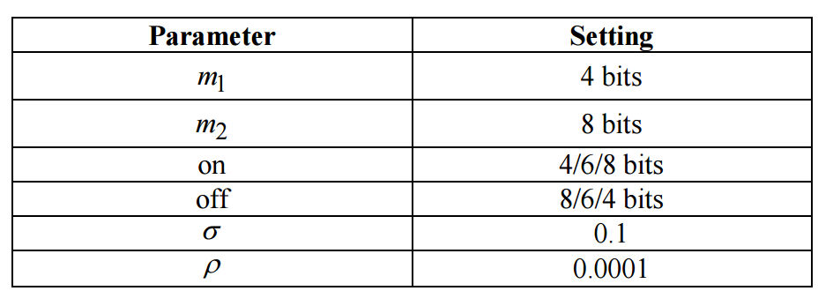
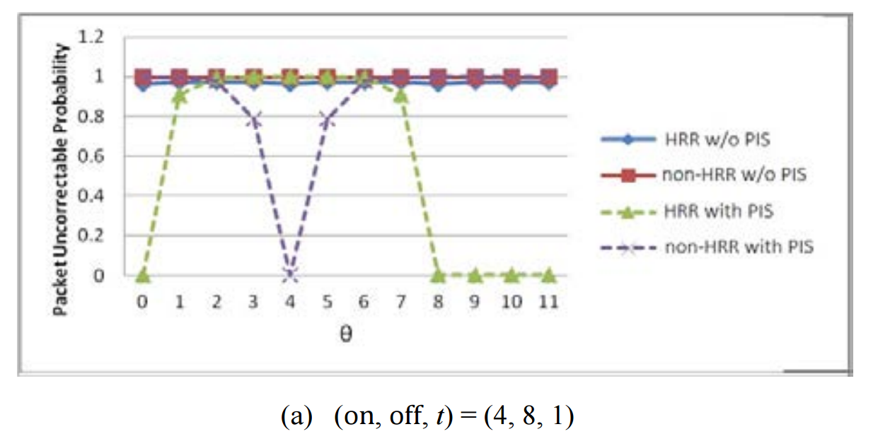
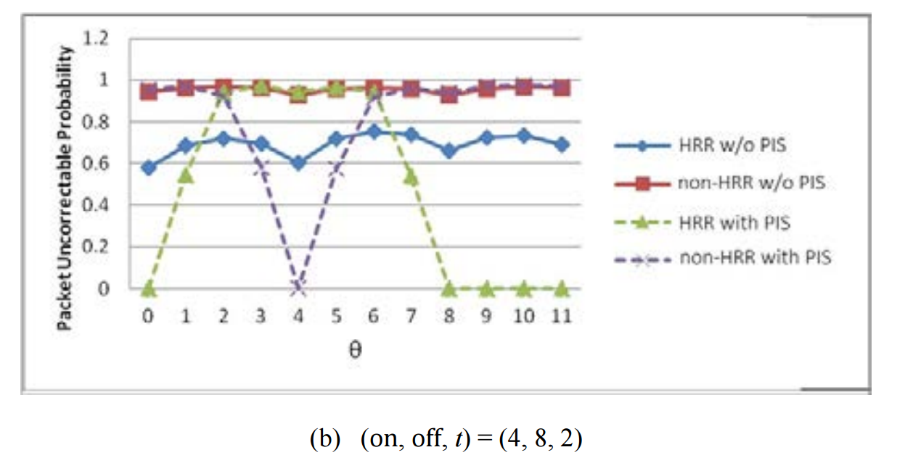
Performance

Slide 15
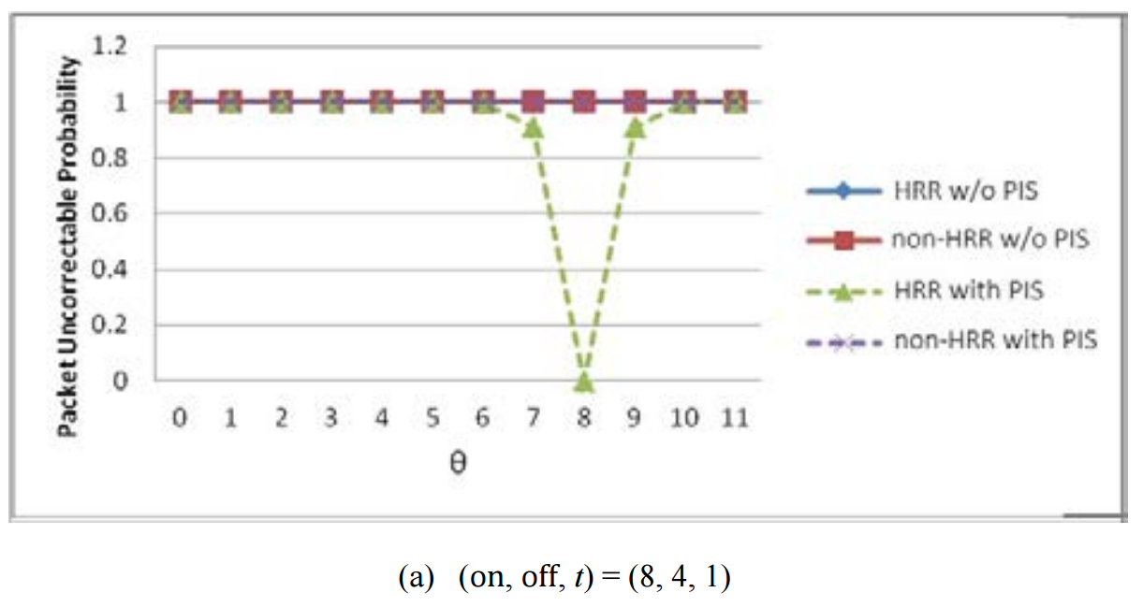
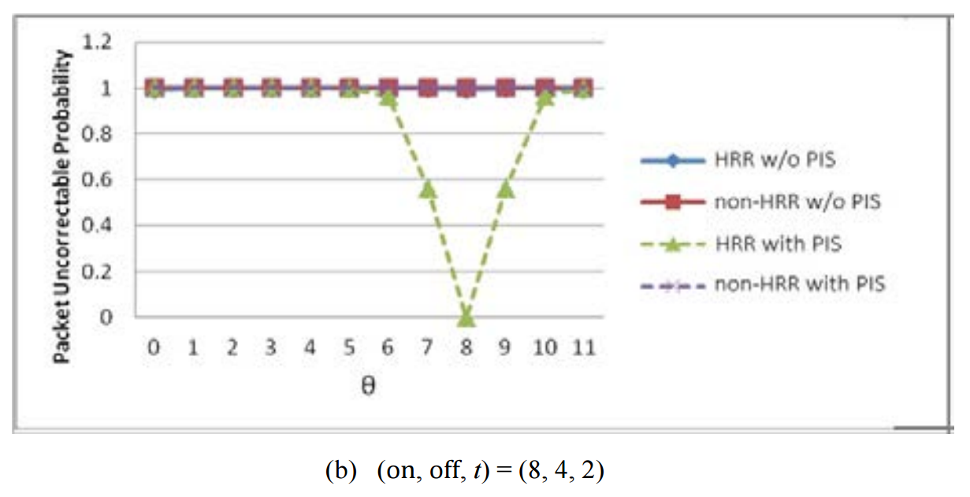
Performance

Slide 16
Performance

